Slide 1
Attention Layer and Language Model
J.S Kim
2021.06.22

Slide 2
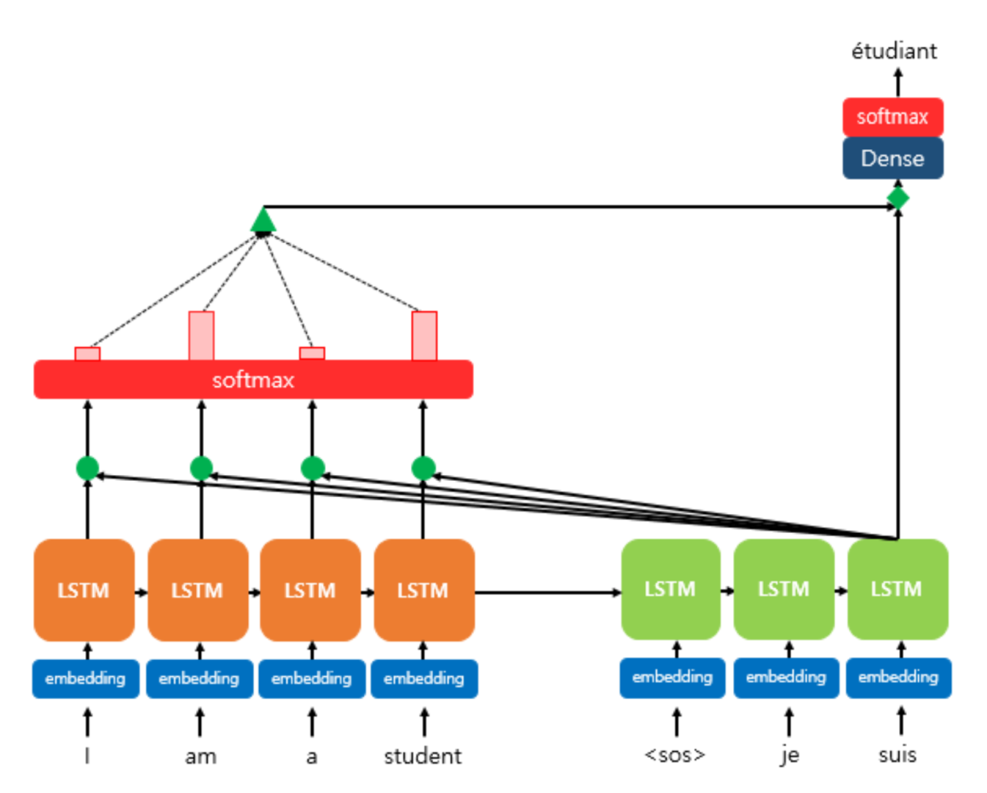
Introduction to Attention Layer
Main Idea: Refering total sentence(or serial data) as a context vector while decoding the output word(or value) for each time steps.
Process: attention weights, context vector, attention vector should be calculated
Context vector

Slide 3
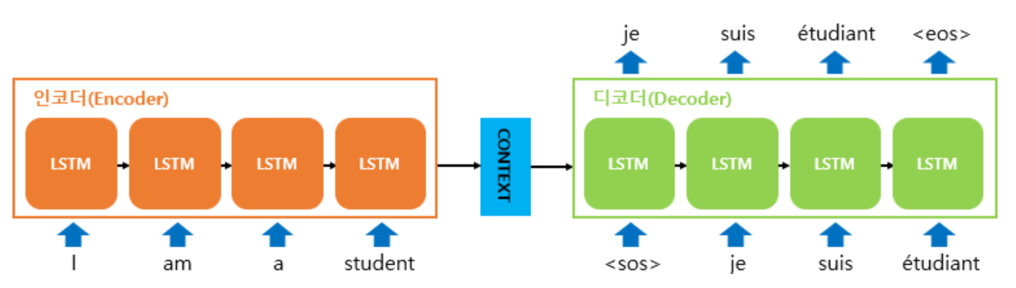
Sequence-to-Sequence model
Model Structure: Encoder + Decoder
Encoder: Convert input data(= sentence) to context vector
Decoder: Convert context vector to output data(= translated word, sentence, etc)
Context vector: last hidden state of Encode RNN cell(= initial hidden state used in Decoder RNN cell)
Symbol: end word
Symbol: start word

Slide 4
Sequence-to-Sequence model
Process: Training + Test
Training: use context vector from Encoder and translated sentence including <sos> and <eos>
Test: use context vector and <sos> / <eos>
Ignore(for test)

Slide 5
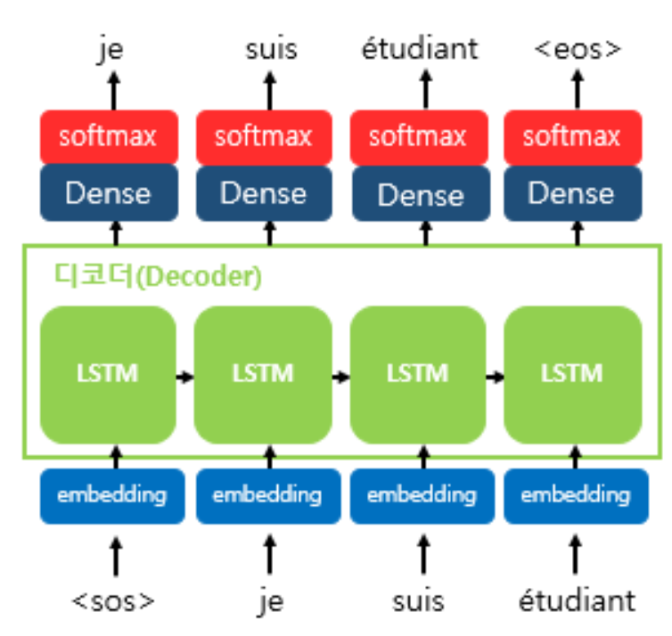
Sequence-to-Sequence model
Decoder: RNN cell(=LSTM), dense layer and Softmax layer
RNN cell: using hidden state at t-1 , input data(translated word) at t to provide hidden state at t
Dense Layer: affine transform
Softmax: calcalate probability to choose the translated word
Context Vector

Slide 6
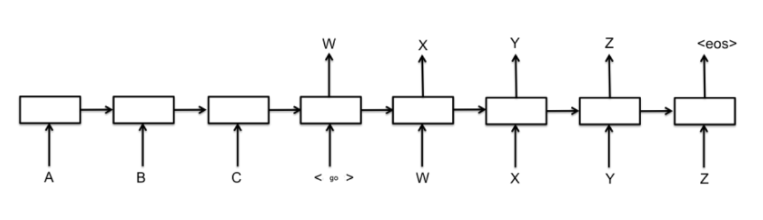
Limit of seq2seq model
Dependency of sequence length: if the length of the source & target sequence is long, quality of context for output sequences is low.
Solution: Using specific weights for each hidden states of encoder to generate attention score, decoder can refer to whole sequence data for each timesteps.
Attention score

Slide 7
Attention Mechanism
Attention Layer: Using attention weights for each time step of decoding process, reflect the previous sequential data for each time step and select the most appropriate target word vector from attention distribution
Process
Attention Score
Attention Distribution
Context vector from attention weights and hidden states from encoder
Concatenate context vector and hidden states from decoder
Affine transform and apply softmax to get the translated word vector

Slide 8
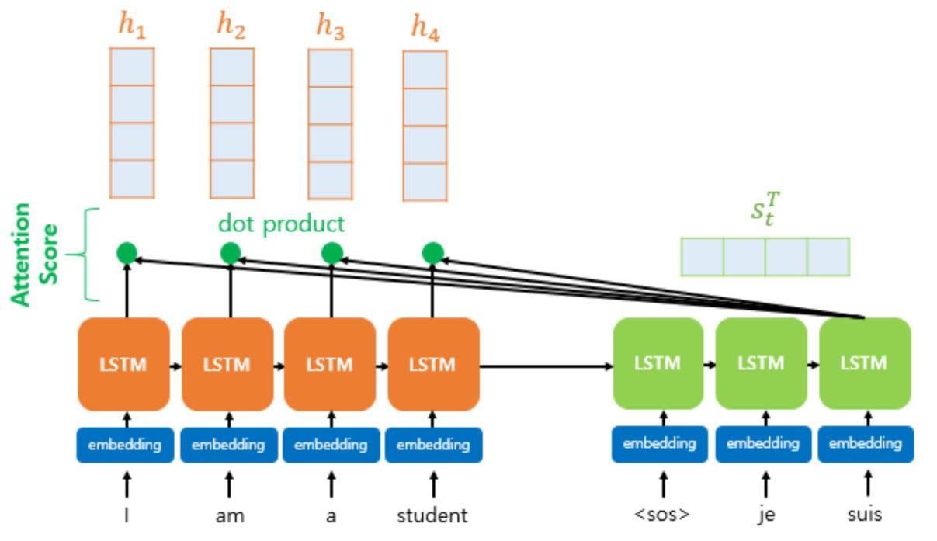
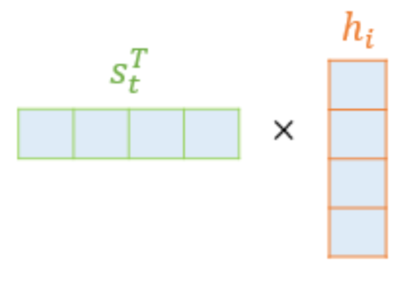


Attention Mechanism
Attention Score
Hidden states h of Encoder from input sequence data
Hidden state s of decoder at time step t
Dot product to get Attention Score(= similarity)
S: hidden state from decoder at t
H: hidden state from encoder corresponding i-th word

Slide 9
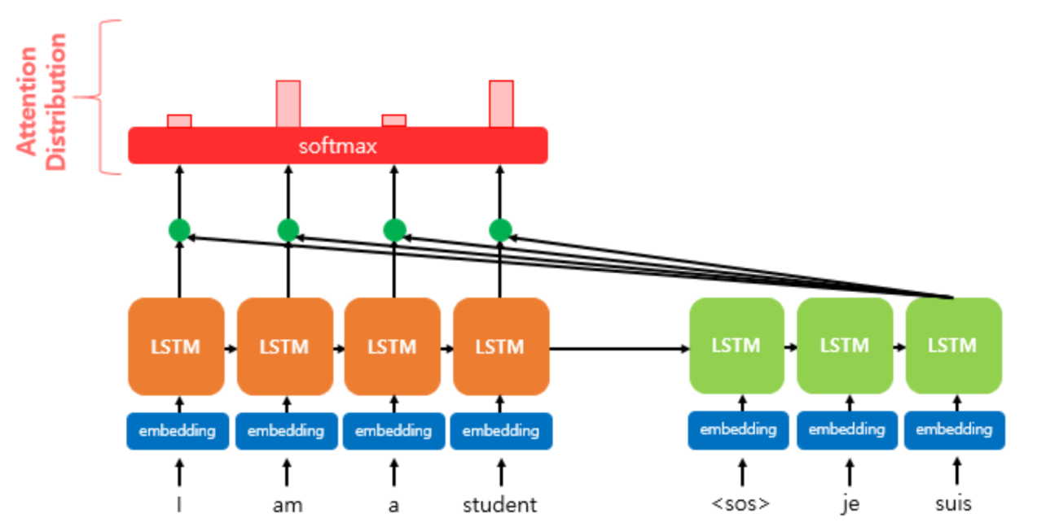

Attention Mechanism
Attention Distribution
Use Attention Weights for each time step t and softmax to get the distribution
The distribution = Normalized Similarity between whole words of input sentence and target word

Slide 10
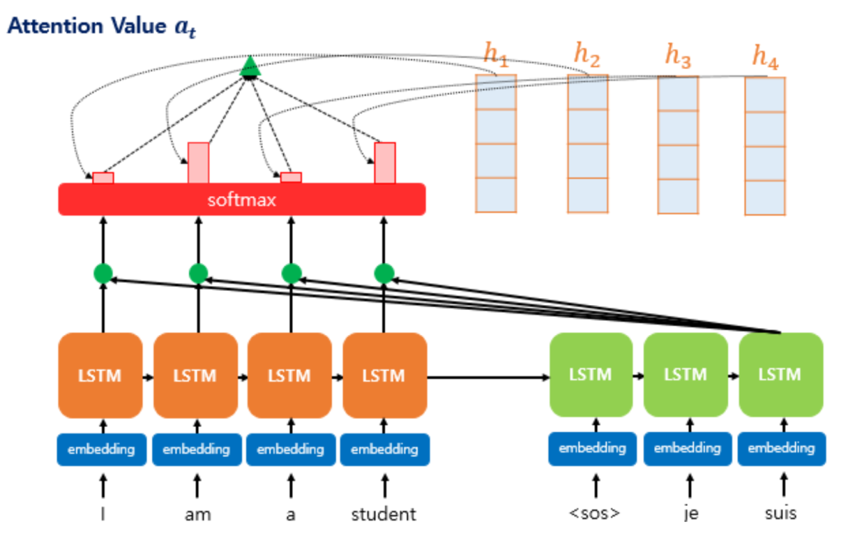
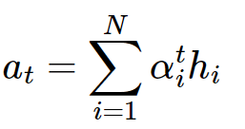
Attention Mechanism
Attention Value(=Context Vector)
Get Context Vector which reflect the similarity of the source words from weighted sum
Context Vector will be used for concatenating with hidden state from decoder at time t
Hidden states from last encoder cell

Slide 11
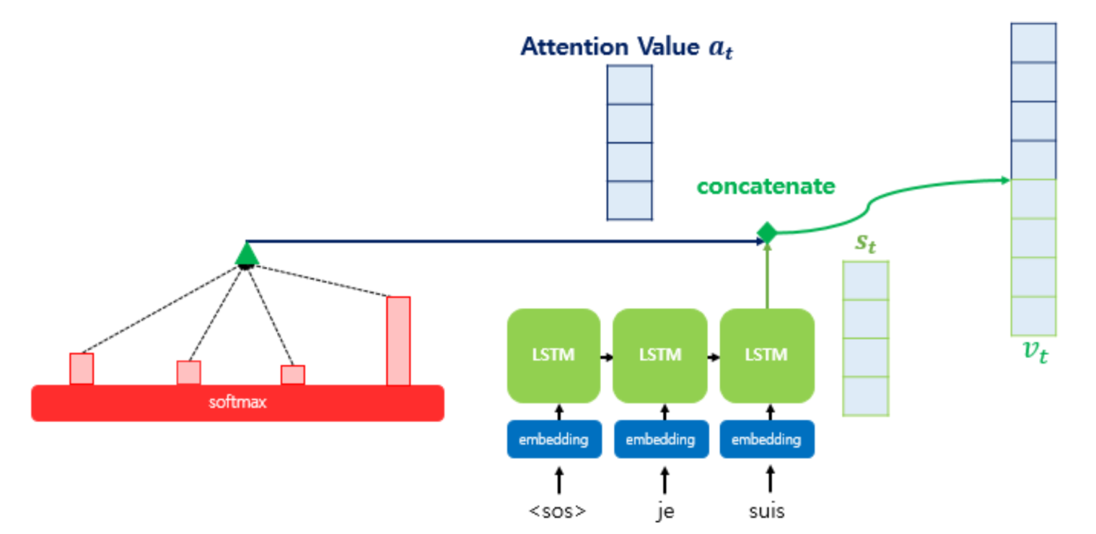
Attention Mechanism
Concatenate context vector / hidden state
By concatenating two vectors, previous sequential data would be reflected for each time step

Slide 12
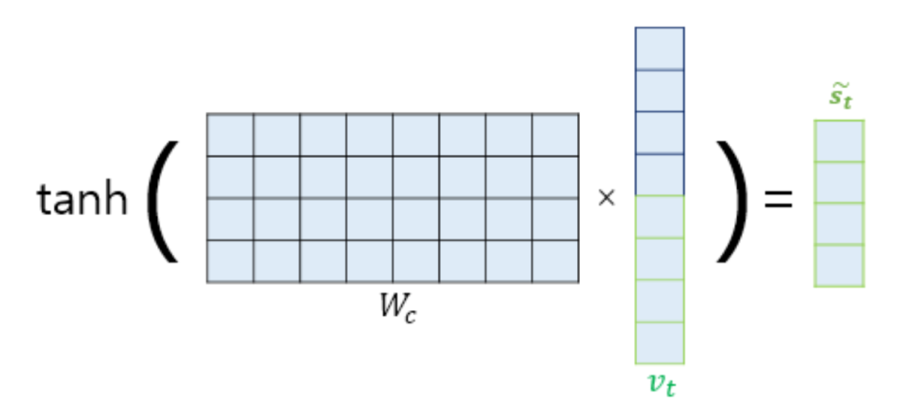


Attention Mechanism
Affine transform & softmax for translating target word
By concatenating two vectors, previous sequential data would be reflected for each time step

Slide 13
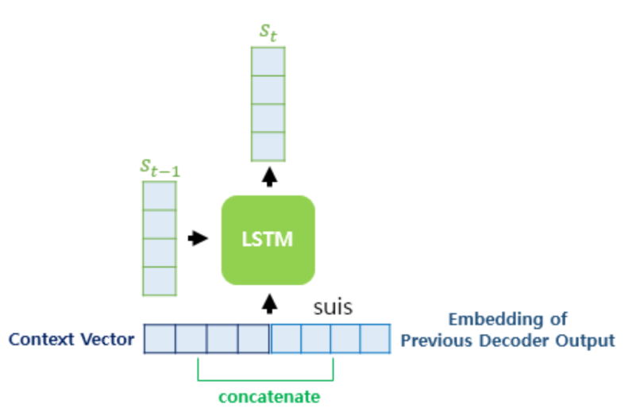
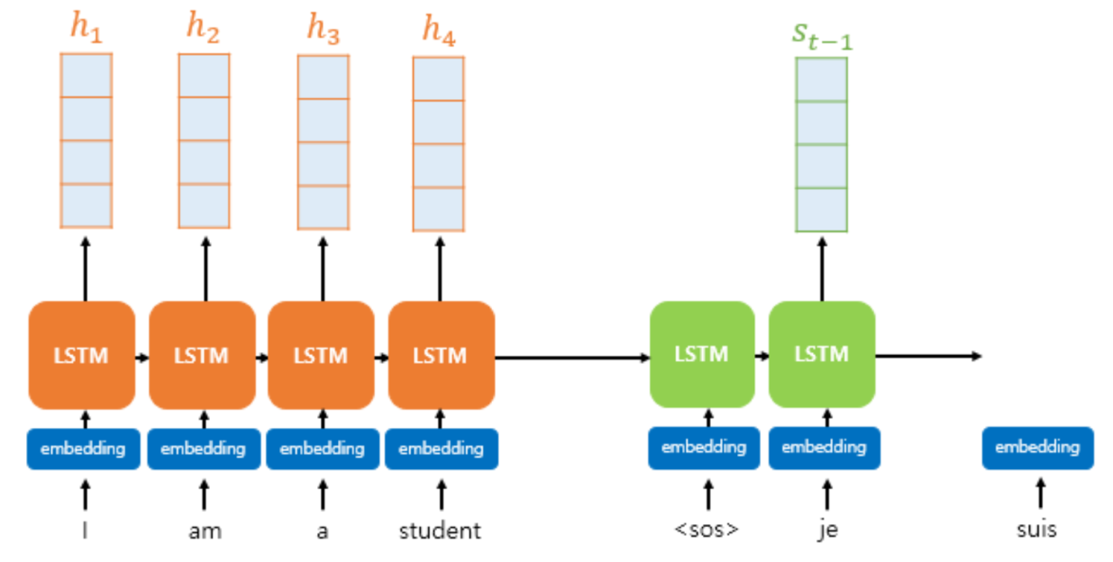

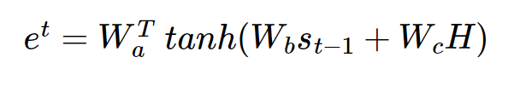
Bahdanau Attention
Using previous hidden state from decoder cell as Query
Process: same as Attention Layer except using previous hidden state from decoder

Slide 14
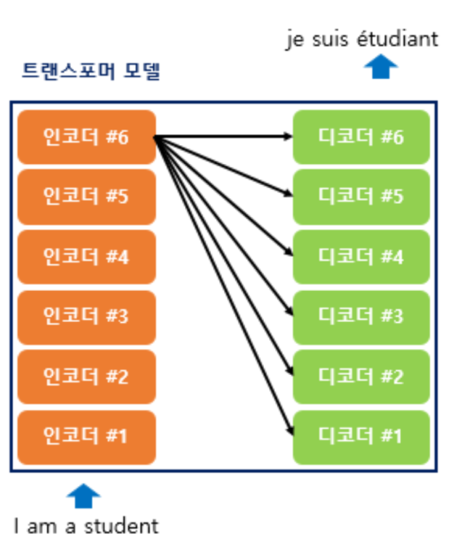
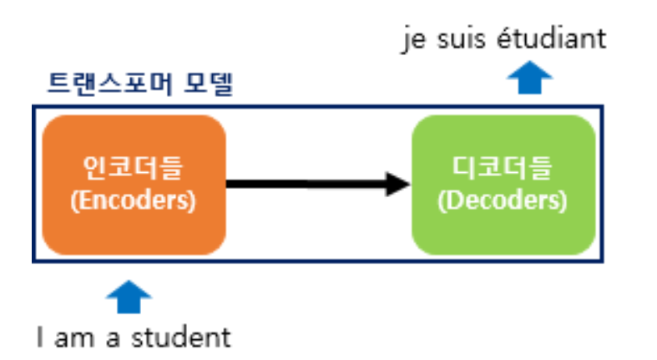
Transformer
Seq2Seq model
Structure: Encoder(RNN) + Decoder(RNN). Loss of input sequence due to the characteristics of RNN exist.
use Attention layer to compress whole previous information into the context vector
Transformer
Structure: Encoder + Decoder without RNN cells.
seq2seq( 1 Encoder/Decoder with RNN cells), transformer(N encoder cell + N decoder cell)

Slide 15
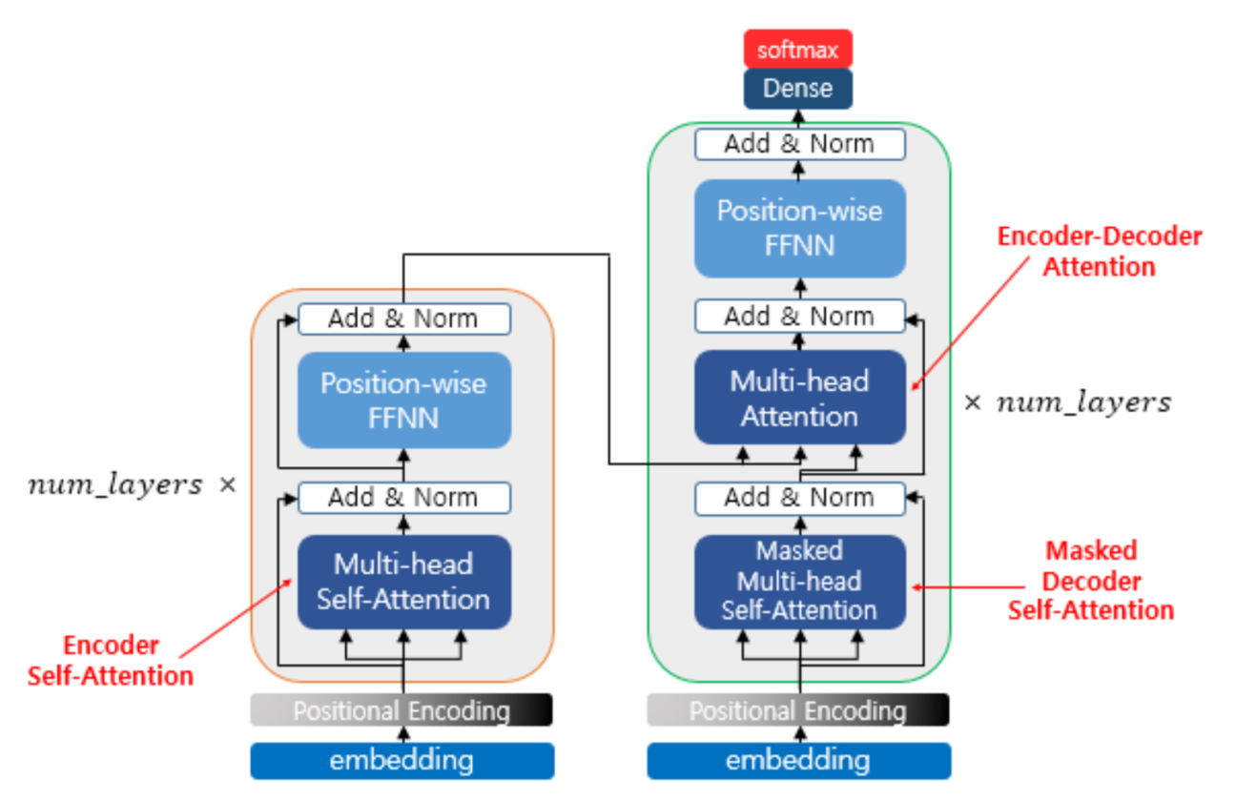
Transformer
Model Structure
Positioning Encoding: to conserve serial order information from input sequences without RNN cells
Encoder Self Attention: using Q,K,V vector for each word to find out the relation between each word in input seq.
Masked Decoder Self Attention: Look-ahead masking
Encoder – Decoder Attention: same as general attention layer

Slide 16
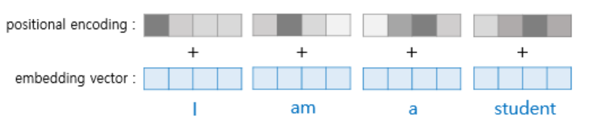
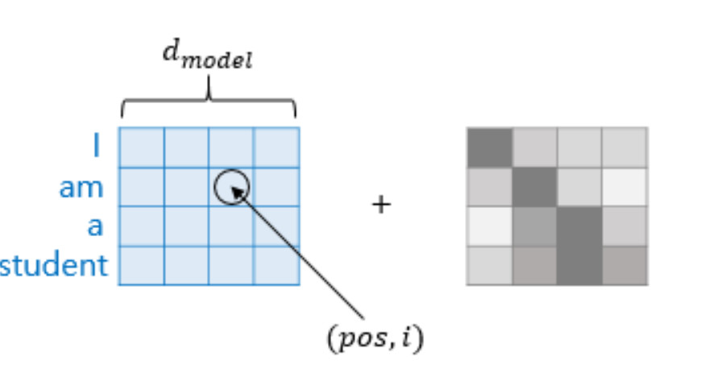
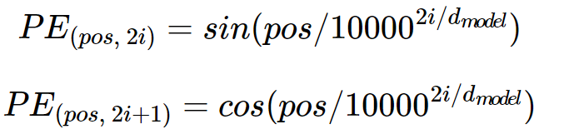
Transformer
Positioning Encoding
using sin / cos function to add the phase(serial order) to embedded word vector
PE matrix

Slide 17
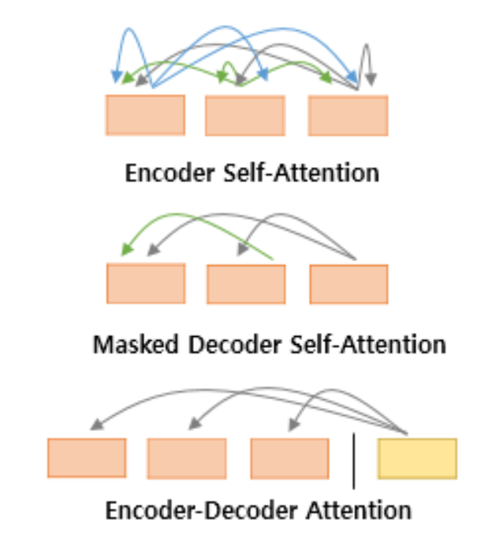
Transformer
Attention Mechanism in Transformer
Relationship between each word in input sentence
Self-Attention + Masking
(except the data after t timestep)
Concatenate Context vector from Encoder with decoder hidden states

Slide 18
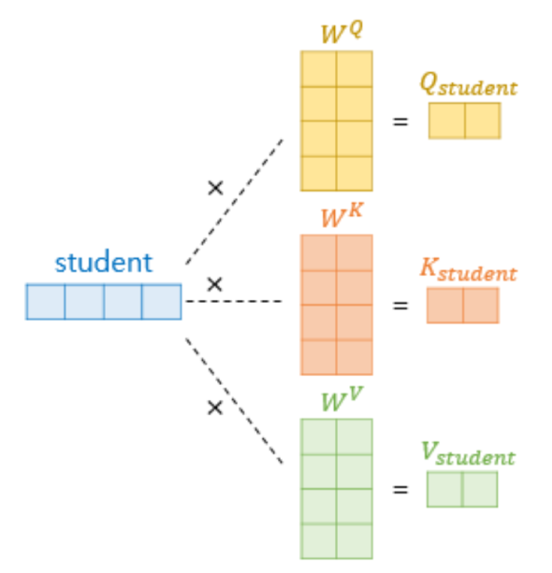
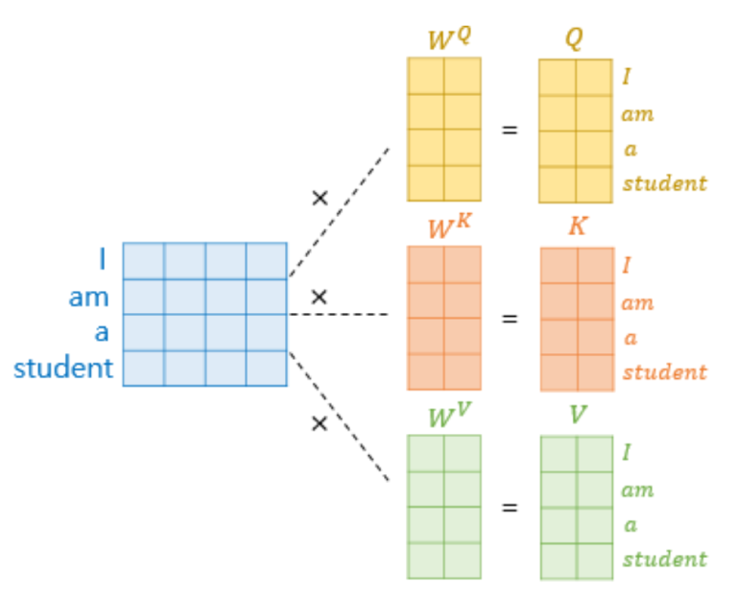
Transformer
Self-Attention
use all word vectors from input sequences
Query, key, value : same ( Q: hidden states from decoder, K:hidden state from encoder, V: hidden state from encoder
parameter: num head, model dimension(d)
Num head: number of Q,K,V weights matrix
Apply dot product with whole input sequences(embedded + positioning encoding)

Slide 19
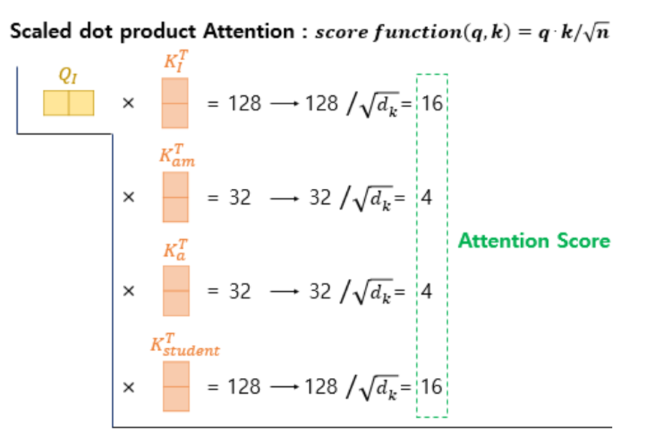
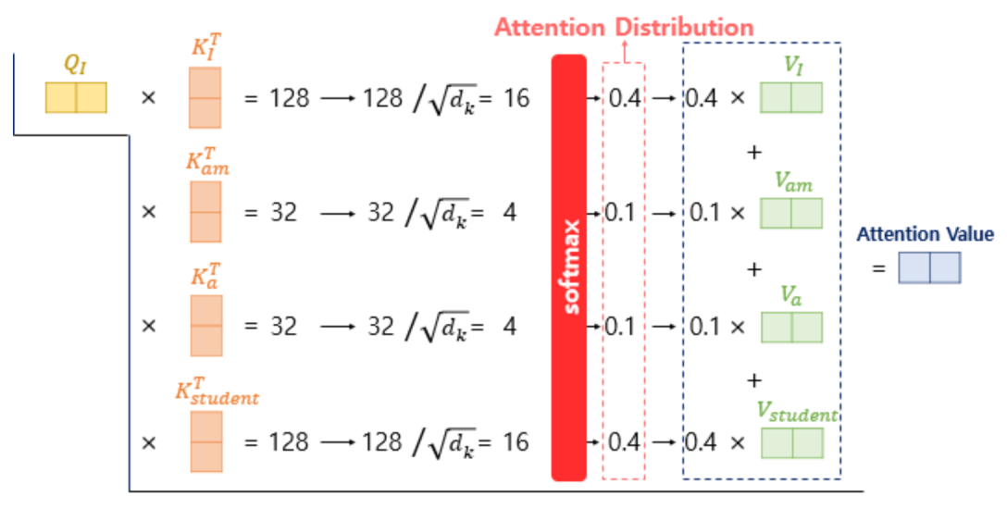
Transformer
Self-Attention
Dot product with scaling(factor : model dimension / num head)

Slide 20
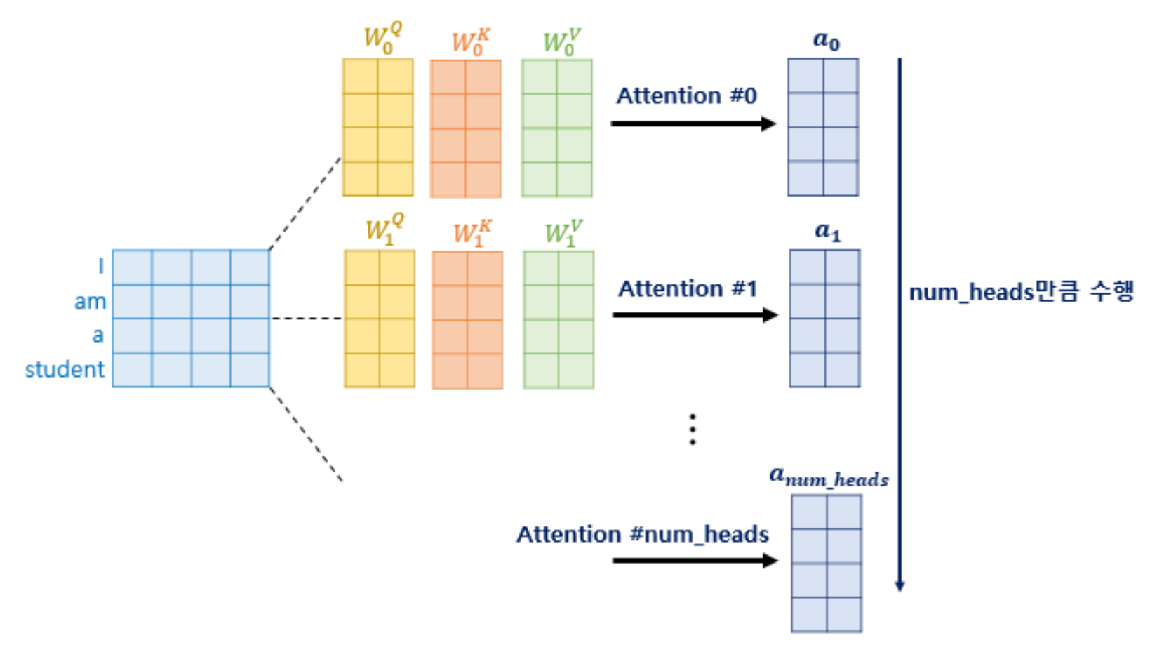
Transformer
Multi-Head Self Attention
num heads: number of Q,K,V weights matrix
use several kinds of Q,K,V weights matrix to product the context vector with complex / various information

Slide 21
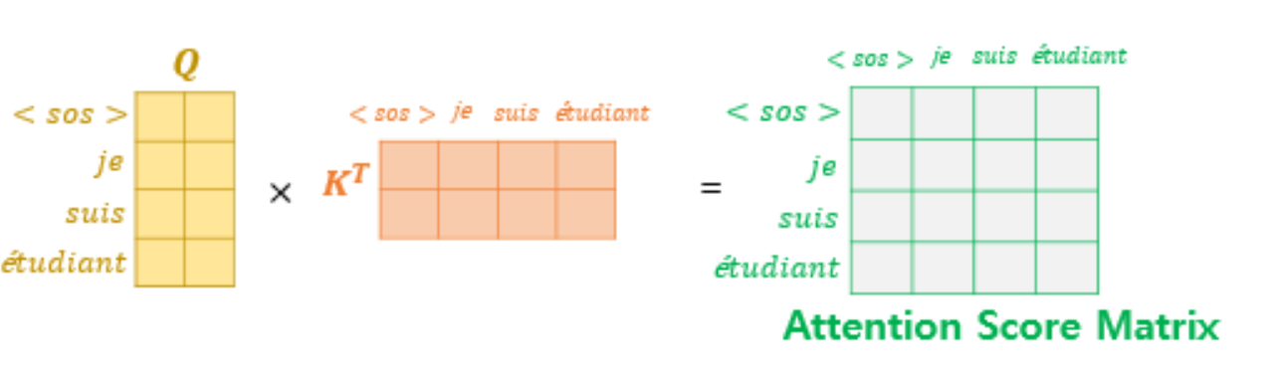
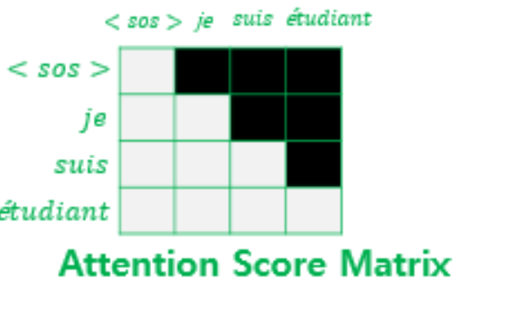
Transformer
Masked Multi-Head Self Attention
Multi – Head Self Attention + Masking(ordering)
Without RNN cells, attention mechanism can not compute the decoder input data sequentially
Masking t+1 word vector to last word vector(decoder) / compute t-th word vector
Masking

Slide 22
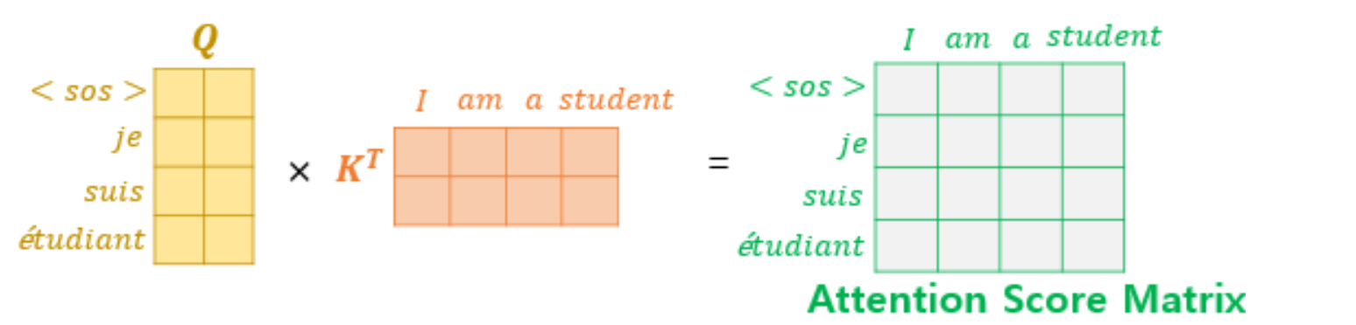
Transformer
Encoder – Decoder Attention
Q: Context vector from Decoder / target sequence data
K: Context vector from Encoder / source sequence data

Slide 23
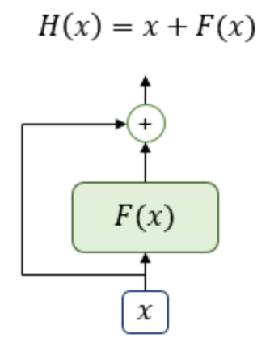
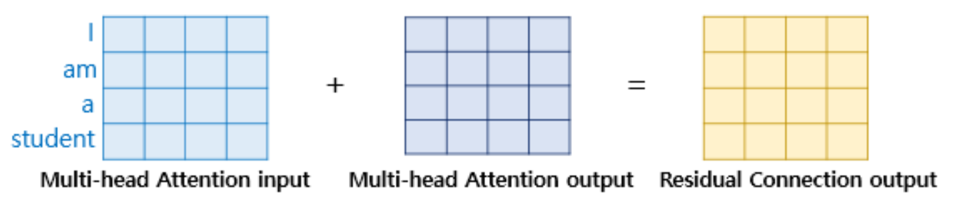
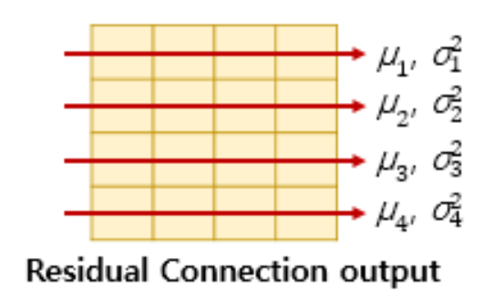
Transformer
Residual Connection
Layer Normalization

Slide 24
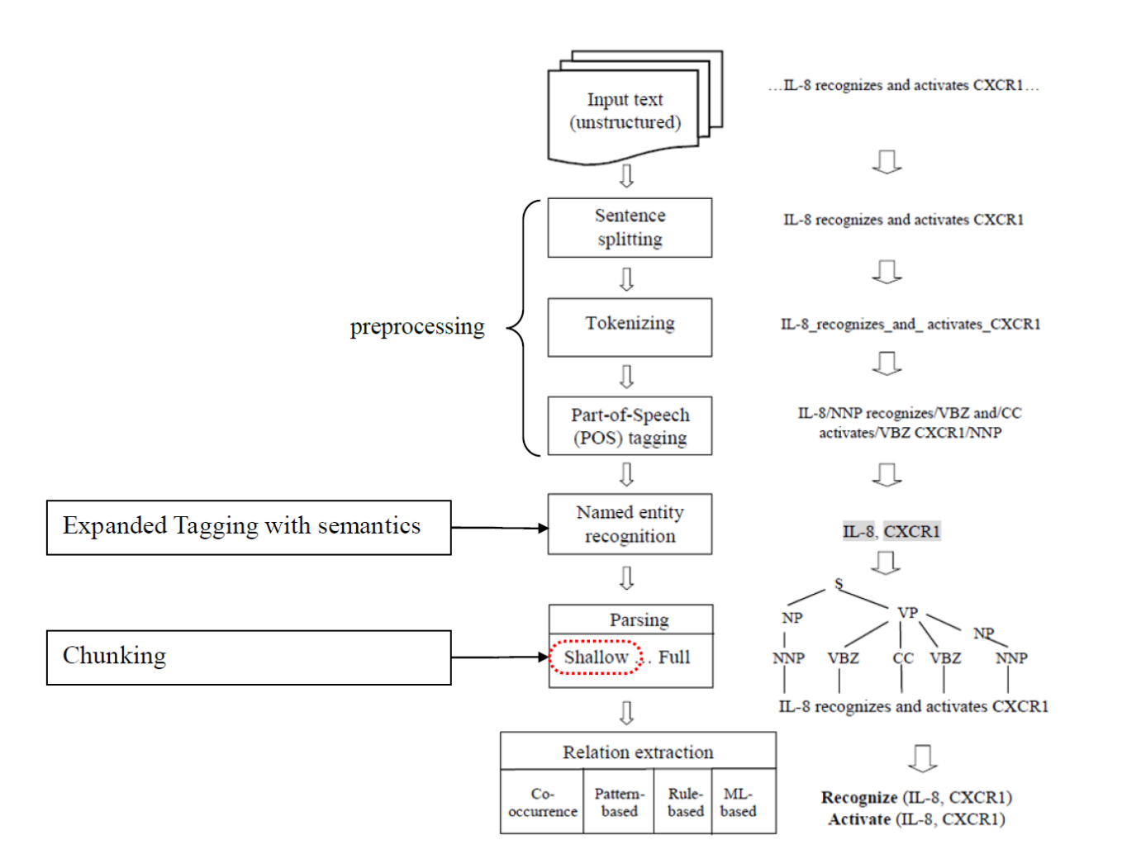
Fundamental of NLP
Natural Language Processing
Phonology
Morphology
Syntax
Semantics
Reasoning

Slide 25
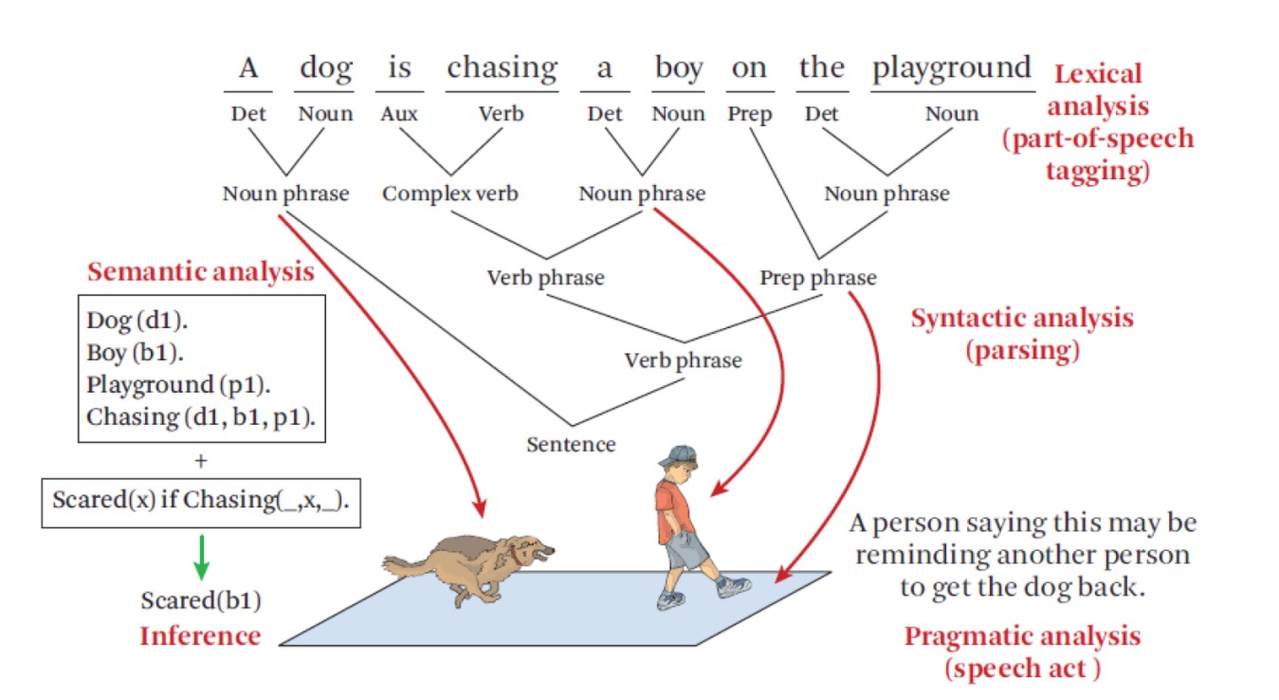
Fundamental of NLP
Natural Language Preprocessing (Example)

Slide 26
Fundamental of NLP
Natural Language Preprocessing (Example)

Slide 27


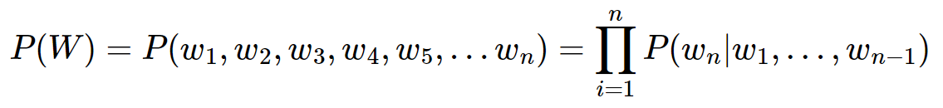
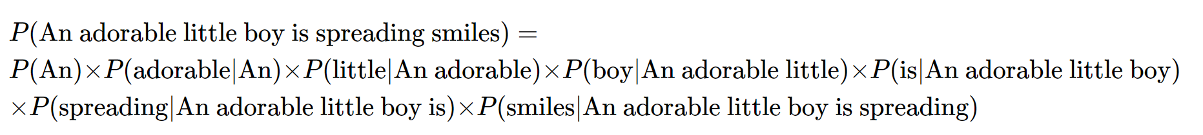
Language Model
Language Model: assign probability distribution of test sequences
Conditional Probability:
Total word sequences probability
Example

Slide 28
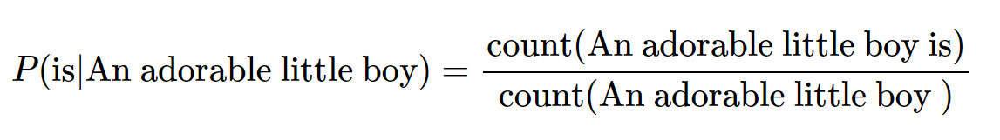
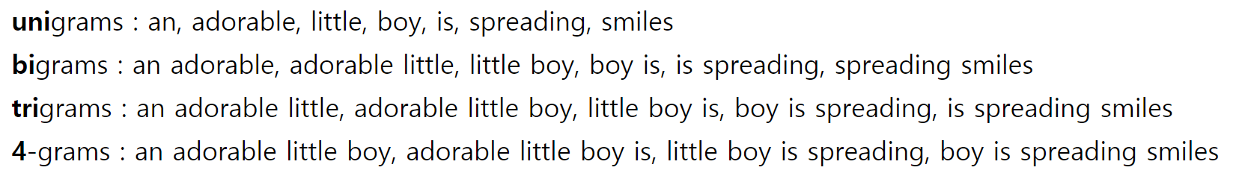
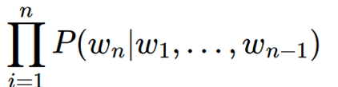
Language Model
Statistical Language Model
Conditional Probability from count – base calculation
Sparsity Problem exists
N-gram Language Model
Tokenize N number of corpus as one token
Select N : trade – off , sparsity problem
Use (n-N, n-N+1, …n-1) sequences

Slide 29
Language Model
Statistical Language Model
Conditional Probability from count – base calculation
Sparsity Problem exists
N-gram Language Model
Tokenize N number of corpus as one token
Select N : trade – off , sparsity problem
Use (n-N, n-N+1, …n-1) sequences

Slide 30
Preprocessing for text sequence for Neural Network
Word Embedding
Convert sparse vector to dense vector with embedded dimensions
Embedding vector(low dim)
Use input data as one-hot encoding vector
Tokenize, Padding, one-hot encoding
Using corpus Analysis module(nltk, konlpy etc) to split the sentence as a unit of token
Padding: unify the length of the sequence (input 0 or dummy value)
One-hot encoding: word index to binary vector

Slide 31
Preprocessing for text sequence for Neural Network
Natural Language Processing
Tokenize
Cleaning, Normalization
= Removing unnecessary words
* stopwords(불용어, 자주 등장하나 의미 x)
* Lemmatization(표제어 추출, stem 어간, affix 접사)
* Regular Expression
Integer coding
mapping word into integer index
vocab_size, counts
Padding
add 0 or dummy value for unifying the sequence length
One hot Encoding
convert Integer sequence into binary sequence
Embedding
covert sparse vector into dense vector(low dimension)

Slide 32
Example with Codes
Word Level Translation: Eng – Kor, Eng - Fra
Compare with seq2seq, attention
프랑스어 번역 vs 한국어 번역
한국어: 어순이 중요치 않다, 교착어(조사), 띄어쓰기의 중요성이 낮다.
프랑스어: 인도유럽어족(영어 등)
데이터셋의 차이

Slide 33
Reference
[1] Attention is all you need, Ashish Vaswani at el, 31st conference on Neural Information Process system.
[2] An analysis of Attention Mechanisms: The case of word sense disambiguation in neural machine translation, Gongbo Tang et al,

